Slide 1
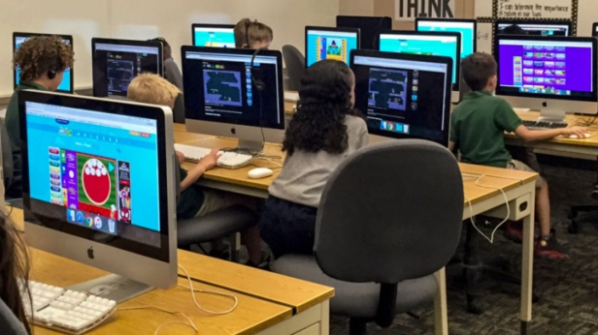
EXAMPLES OF ROBOTIC CODING ACTIVITIES
through “LEARNING BY DOING” methods
UNPLUGGED activities and ON-LINE activities
ROBOTIC Coding using
BEE-BOT e BLUE-BOT
+
(www.code.org)
(https://programmailfuturo.it)

Slide 2
Algorithm
At the root of all computer science is something called an algorithm. The word “algorithm” may sound like something complicated, but really it’s just a list of instructions that someone can follow to achieve a result. To provide a solid base for the rest of your students’ computer science education, we’re going to focus on building a secure relationship with algorithms.

Slide 3
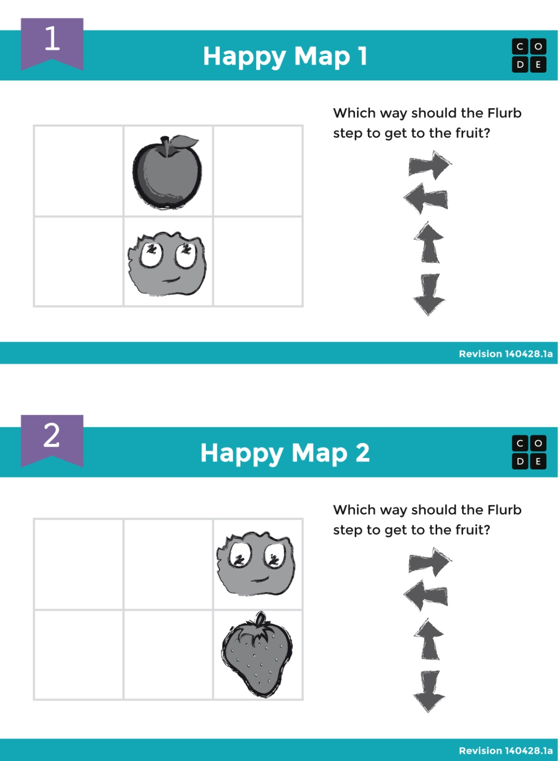

Slide 4
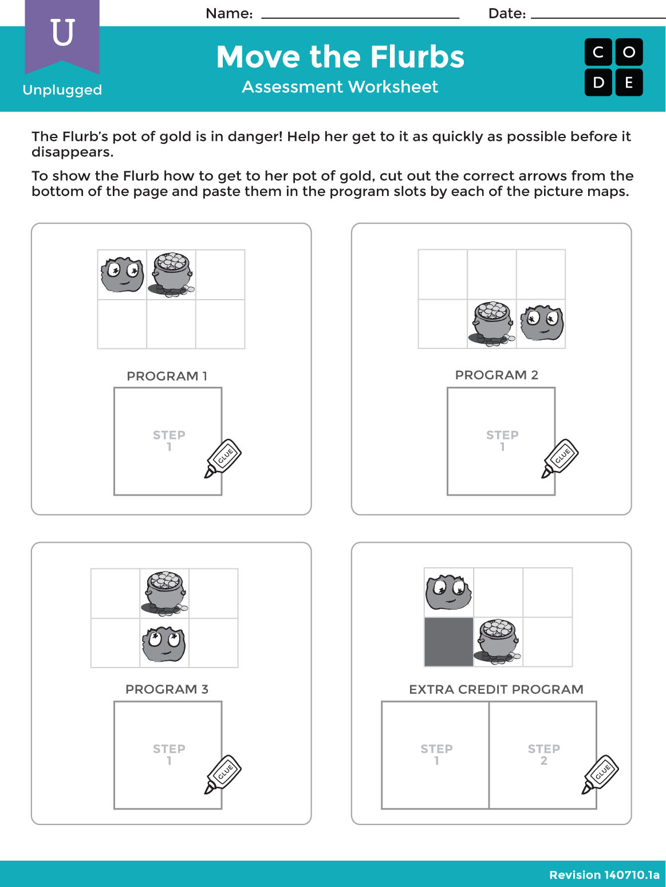

Slide 5
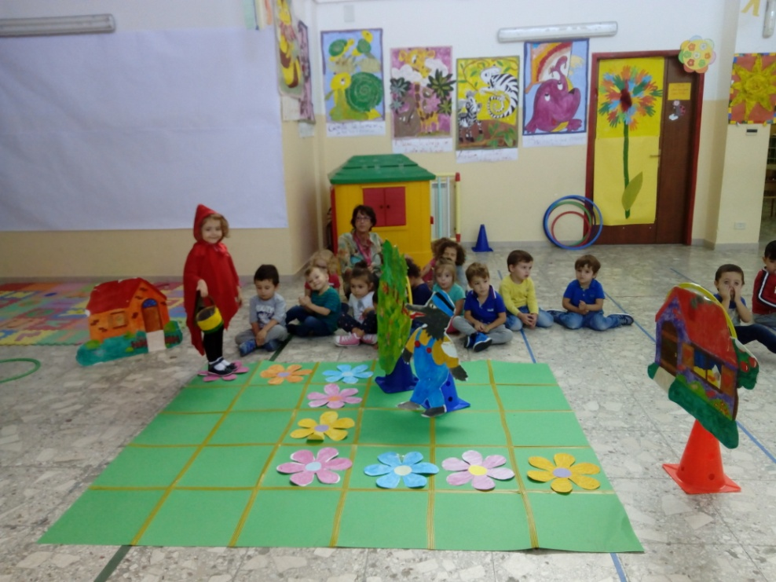
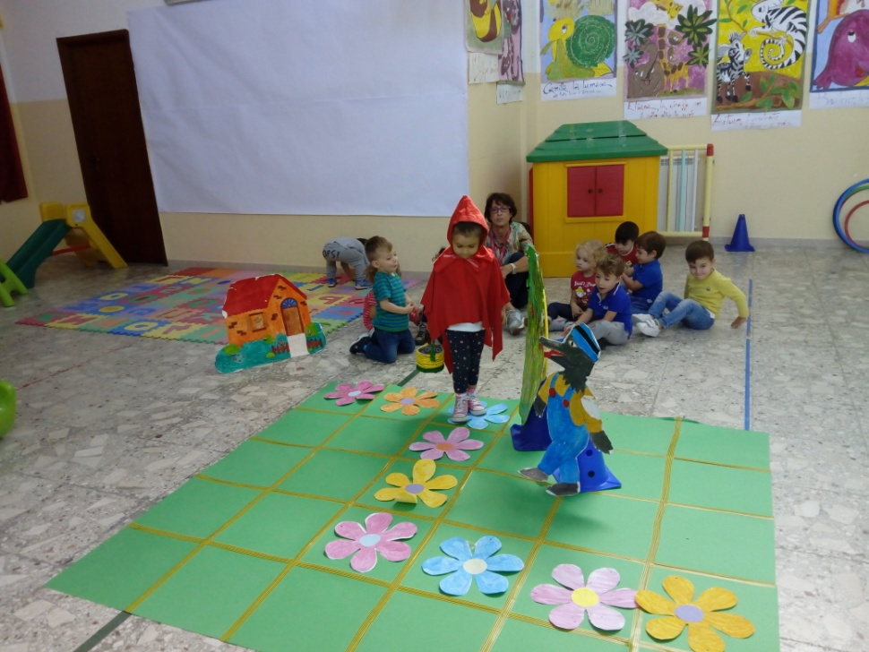
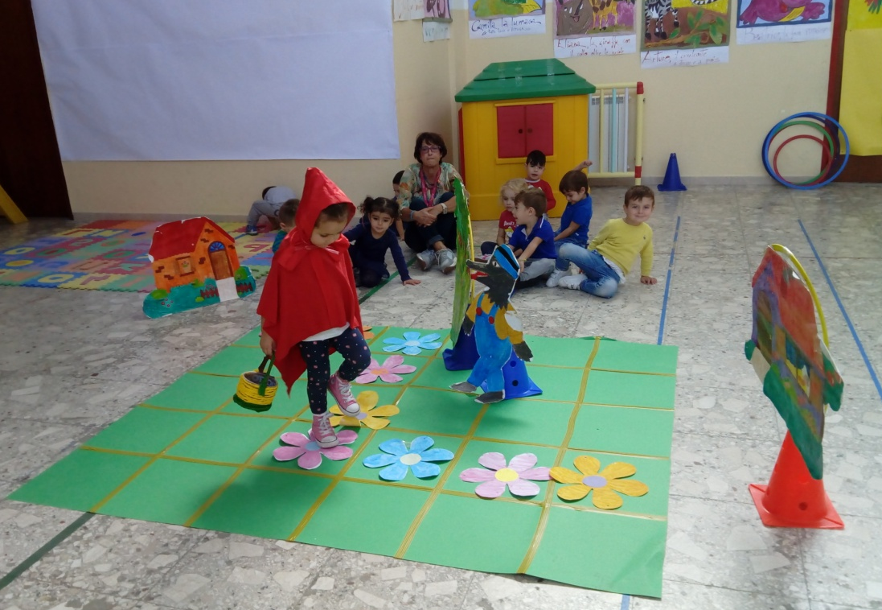
Little Red Riding Hood
Reticular sheets
with a route to follow

Slide 8
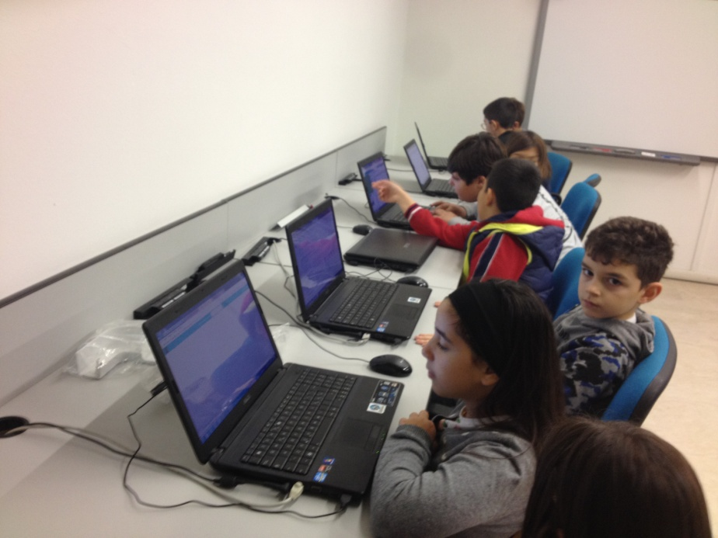
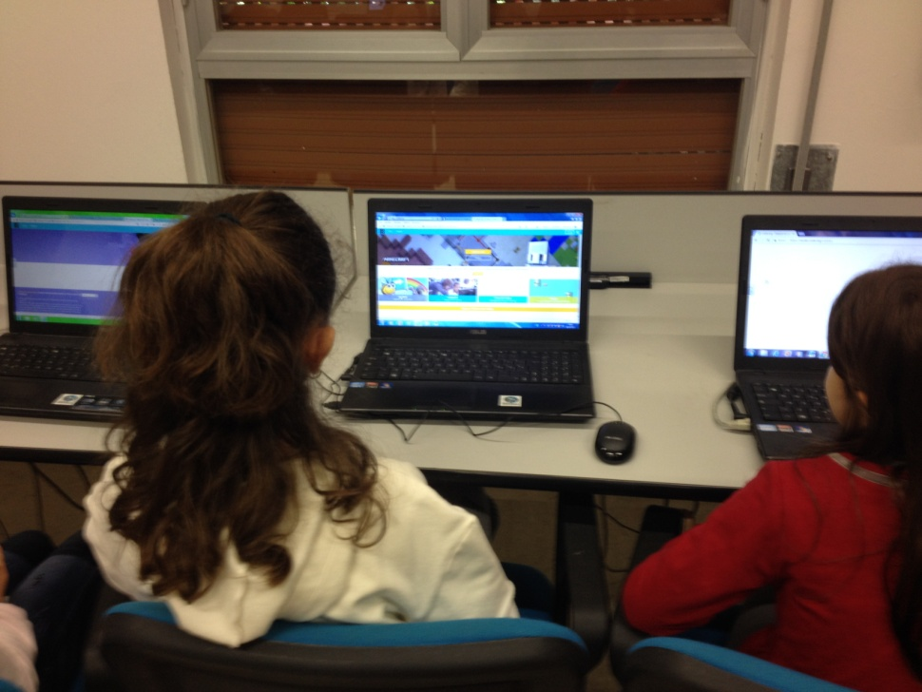
On-line activities

Slide 10
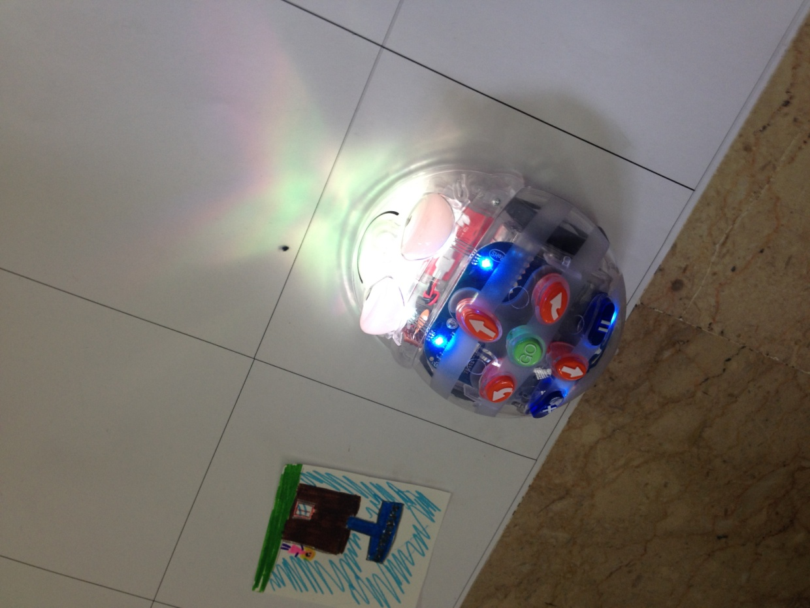
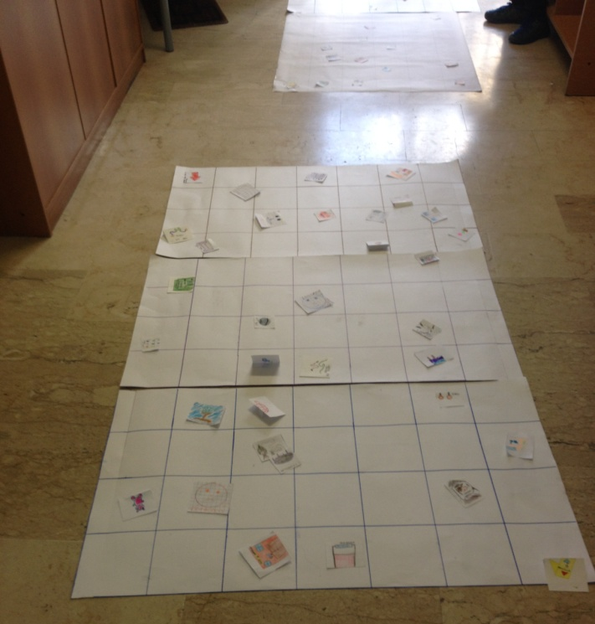
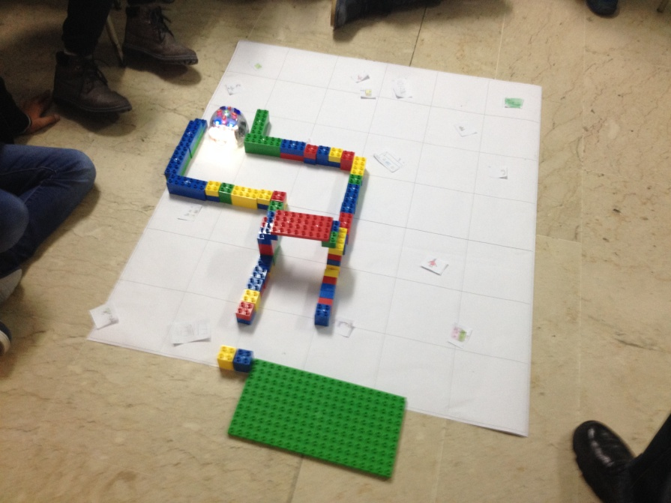
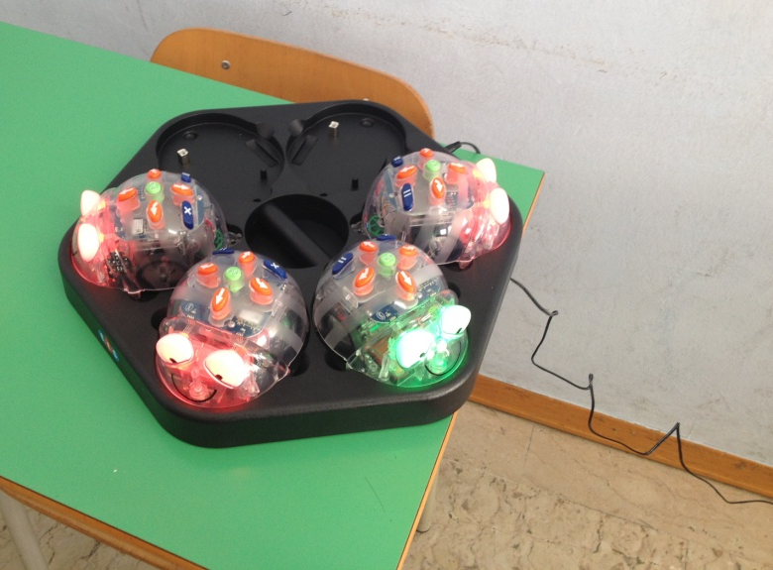
Robotic – Blue bot

Slide 12
Thank you
Rose Foti,
Sicily

